Slide 1


Smart Parking System — Data Analysis Report
Reg. No: 2117250020045
SMART PARKING SYSTEM
Data Analysis Report All six analytical visualisations — Line Plot · Scatter Plot · Histogram · Heatmap · Bar Chart · Pie Chart Submitted by A. Chaitanya Registration No: 2117250020045 Faculty Guide Dr. Anwar Basha Department of Computer Science & Engineering
A. Chaitanya | Faculty: Dr. Anwar Basha
Page 1 of 7

Slide 2
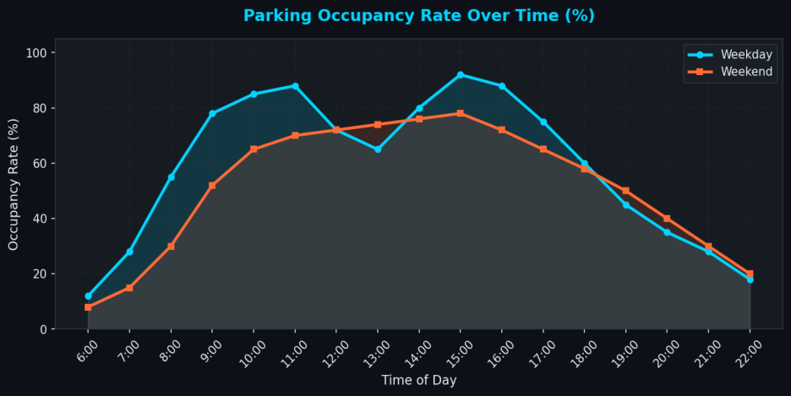
Smart Parking System — Data Analysis Report
Reg. No: 2117250020045
Graph 1 — Line Plot: Parking Occupancy Rate Over Time
A time-series line plot comparing weekday and weekend occupancy rates across all operating hours (6 AM – 10 PM). Each
data point represents average occupancy % measured across 30 days of sensor logs.
Key Insights
Peak Hour
Weekday occupancy peaks at ~92% between 10 AM–12 PM, reflecting office commuter demand.
Weekend
Weekend peak is lower (78%) and sustained longer, indicating leisure-based visits.
Off-Peak
Both curves dip below 30% before 7 AM and after 9 PM — lowest sensor load windows.
A. Chaitanya | Faculty: Dr. Anwar Basha
Page 2 of 7

Slide 3
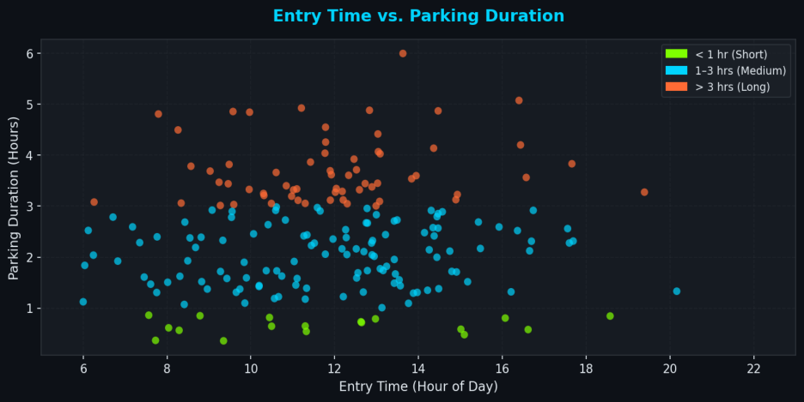
Smart Parking System — Data Analysis Report
Reg. No: 2117250020045
Graph 2 — Scatter Plot: Entry Time vs. Parking Duration
Each point represents a single vehicle session, coloured by duration category. Data collected from RFID entry/exit sensors
across 200 sample sessions.
Key Insights
Short Stays
Vehicles entering after 6 PM tend to stay < 1 hour — quick shopping/dining trips.
Long Stays
Morning arrivals (7–9 AM) show longer durations (3–6 hrs), typical of office workers.
Mid-day
Dense cluster at 11 AM–2 PM with 1–3 hr durations aligns with lunch-hour visits.
Cluster
A. Chaitanya | Faculty: Dr. Anwar Basha
Page 3 of 7

Slide 4
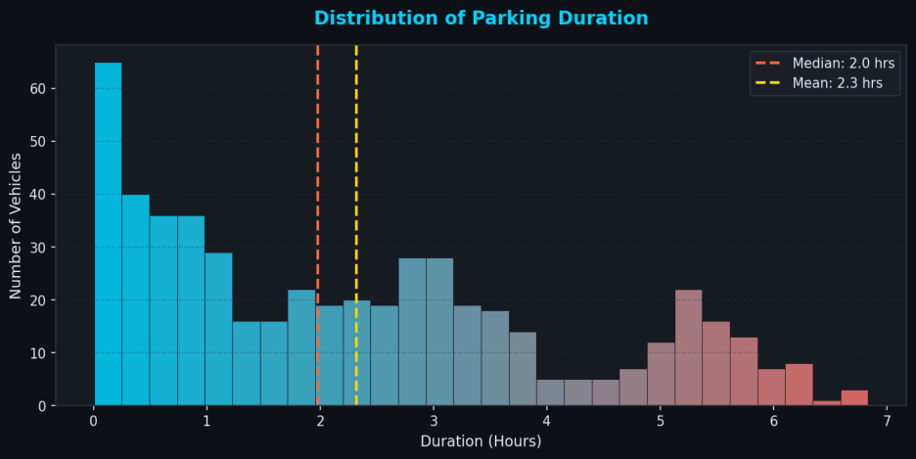
Smart Parking System — Data Analysis Report
Reg. No: 2117250020045
Graph 3 — Histogram: Distribution of Parking Duration
Frequency histogram of parking durations (in hours) across all recorded sessions. The bimodal shape reveals two distinct
visitor behaviours in the smart lot.
Key Insights
Mode
Highest frequency bin is 0.5–1.0 hrs, indicating most visitors are short-term.
Mean vs
Right-skewed distribution; mean > median due to a minority of very long stays.
Median
Secondary
A secondary bump near 3 hrs corresponds to structured lunch/work sessions.
Peak
A. Chaitanya | Faculty: Dr. Anwar Basha
Page 4 of 7

Slide 5
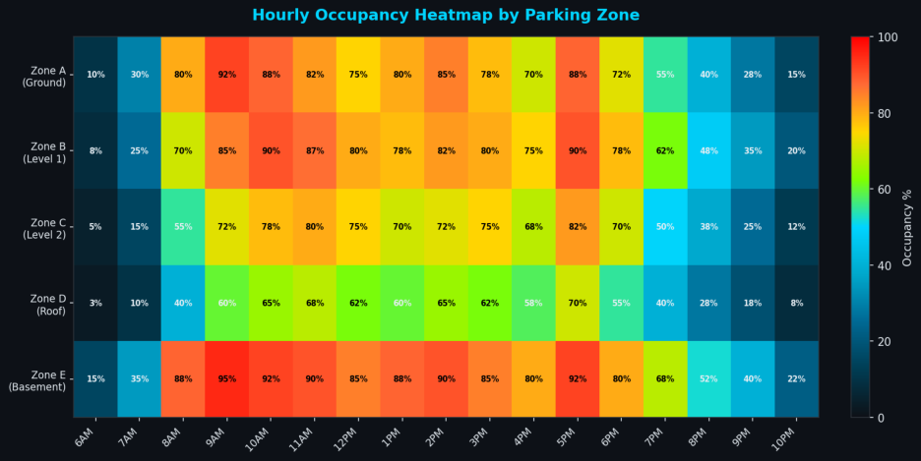
Smart Parking System — Data Analysis Report
Reg. No: 2117250020045
Graph 4 — Heatmap: Hourly Occupancy by Parking Zone
2-D occupancy heatmap across 5 parking zones (rows) and 17 hourly time slots (columns). Values show the percentage of
slots occupied; colour intensity encodes load level.
Key Insights
Hotspot
Zone E (Basement) and Zone B (Level 1) show consistently highest occupancy.
Morning Rush
8–10 AM block shows red-spectrum cells across all zones simultaneously.
Roof Zone
Zone D (Roof) remains below 70% even at peak, offering overflow capacity.
A. Chaitanya | Faculty: Dr. Anwar Basha
Page 5 of 7

Slide 6
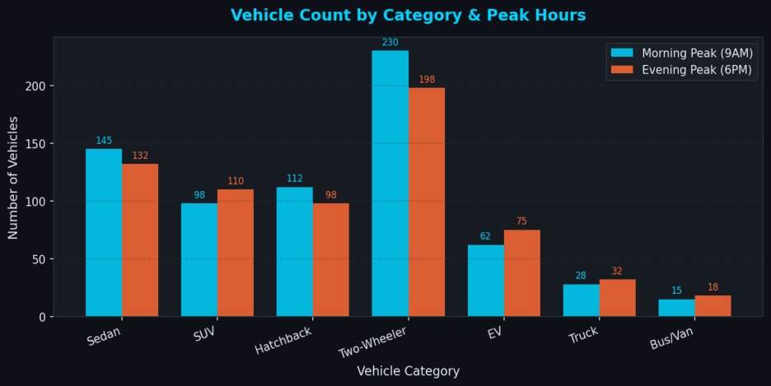
Smart Parking System — Data Analysis Report
Reg. No: 2117250020045
Graph 5 — Bar Chart: Vehicle Count by Category & Peak Hours
Grouped bar chart comparing the number of vehicles per category during the two daily peak windows — morning (9 AM) and
evening (6 PM) — across 7 vehicle types.
Key Insights
Two-Wheelers
Dominate both peaks (230 AM / 198 PM), requiring dedicated bay allocation.
EVs
EV count is higher in evening peak (75 vs 62), suggesting workplace charging patterns.
Buses/Vans
Lowest count; however, each unit occupies 3–4× the space of a sedan.
A. Chaitanya | Faculty: Dr. Anwar Basha
Page 6 of 7

Slide 7
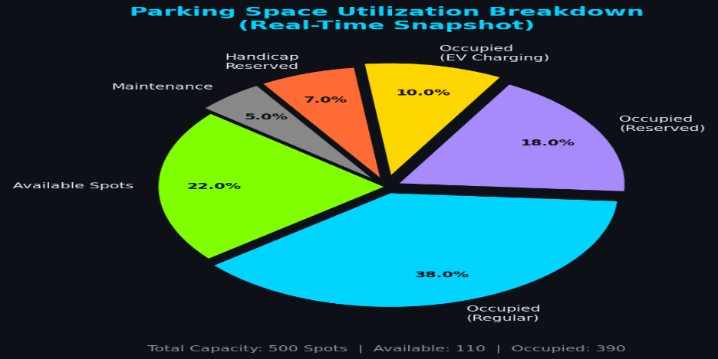
Smart Parking System — Data Analysis Report
Reg. No: 2117250020045
Graph 6 — Pie Chart: Parking Space Utilisation Breakdown
Real-time snapshot of how 500 total parking spots are categorised at peak occupancy. The chart breaks down available,
occupied (regular, reserved, EV, handicap) and maintenance slots.
Key Insights
Occupancy 78% of total capacity is actively occupied at the captured peak moment. Rate EV Share
10% EV-charging slots reflect growing electric vehicle adoption in the city.
Available
22% available spots (≈110 spaces) remain, guiding the dynamic signage system.
A. Chaitanya | Faculty: Dr. Anwar Basha
Page 7 of 7

